Slide 1
Threat & Risk Concepts
Concepts as a foundation for the threat & risk conceptual model

Slide 2
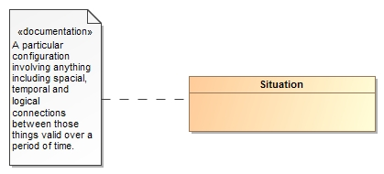
Threats and Risks of What?
A threat or risk is with respect to some undesirable situation
What is a situation?
We define a situation as a configuration of things…
People places, things, events, occurrences and the connections between them.
Some situations are consequences of others
Situations provide a link between different kinds and phases of threats & risks

Slide 3
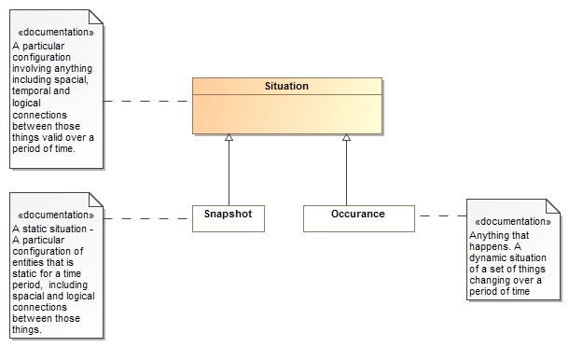
Situations can be a snapshot in time or an event occurring over time

Slide 4

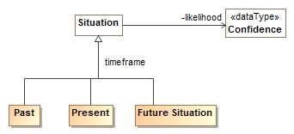
Situations Over Time
Situations can exist in the
Past (History)
Present (Current event)
Future (Expectation)
Past
Present
Future
Noting is for sure – so any situation can have a likelihood

Slide 5


Consequences
The same situation or kind of situation may be desired by some and unwanted by others based on the consequences
Consequences are relative to the objectives of one or more stakeholders
The impact of a consequence can be computed from the likelihood, degree of affect and importance
Benefit
Don’t Care
Detriment

Slide 6
Classifying Situations across time and Consequence
Past
Present
Future
RISK
Benefit
Don’t Care
Detriment

Slide 7
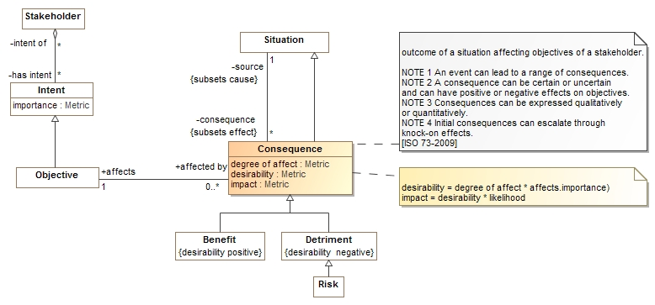
Consequence Model
Situations have consequences (an effect of the situation)
Consequence can be positive or negative: benefits or detriments, respectively
Consequences affect the objectives of stakeholders
This leads to the desirability of the consequence (positive or negative)
Desirability * likelihood provide the impact (risk metric for detriments)

Slide 8
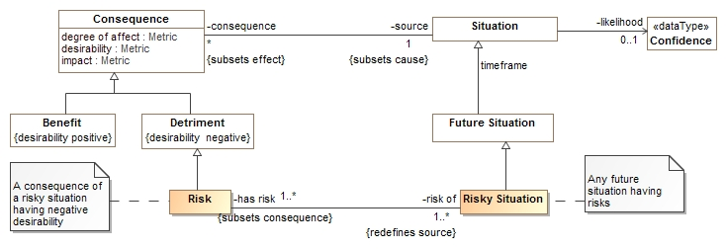
Risk
A risk is a future situation that is a detriment to the objectives of some stakeholder
A risk is the consequence of a risky situation
A risky situation is any future situation with risks (e.g. is a detriment to some stakeholder)

Slide 9
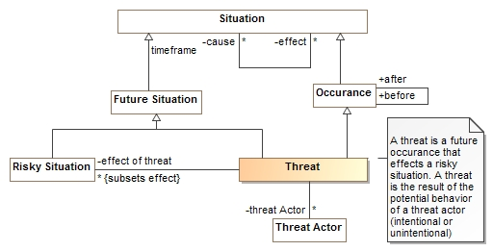
Threat
A threat is an occurrence that leads to a risky situation that is potential behavior of a threat actor
A threat is not necessarily intentional

Slide 10
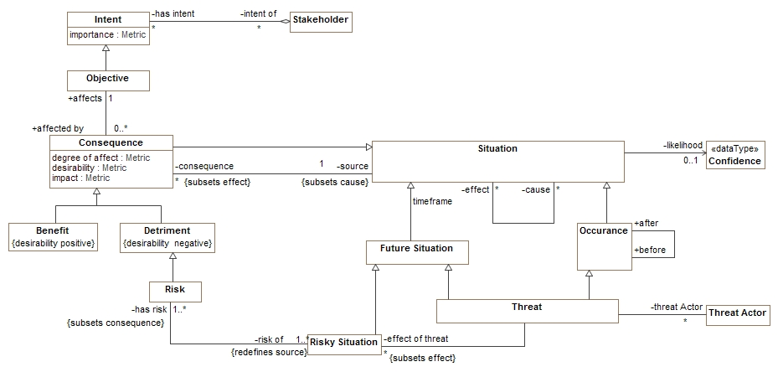
Putting threat and risk together
Note that a situation may be classified by multiple types

Slide 11
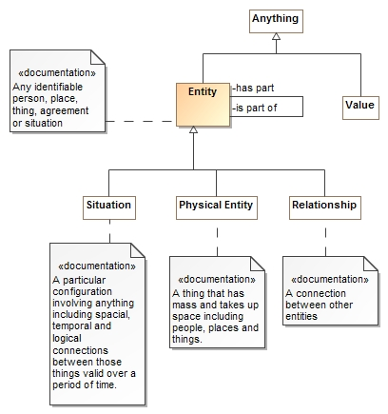
Entities
An entity is something you can identify, or name.
A situation is one kind of “Entity”.
Physical things are also entities
As are contracts, agreements and other relationships
Entities may have “parts” or be part of other things
Things that are not entities are values, like numbers.

Slide 12
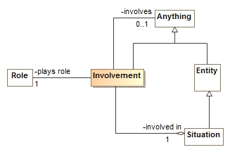
Involvement
Situations involve other things playing roles
The “involvement” relates a situation, the role played and the entity or value involved
Roles are types (categorizations) of things involved in situations
E.g. victim, perpetrator, weapon
Sometimes the actual thing playing the role is unknown, so the involved element is optional

Slide 13
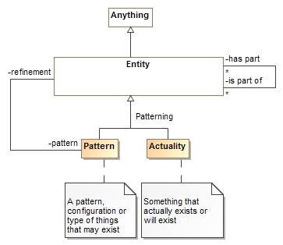
Patterns
Entities (including situations) may be actual things or events or patterns of them.
An “Actuality” is a real thing or something or a specific happening
A pattern can have a refinement (more specific configuration) that is another pattern or actuality
Everything true of a pattern must be true of its refinements.
Involved entities
Parts
Property Values
Rules

Slide 14
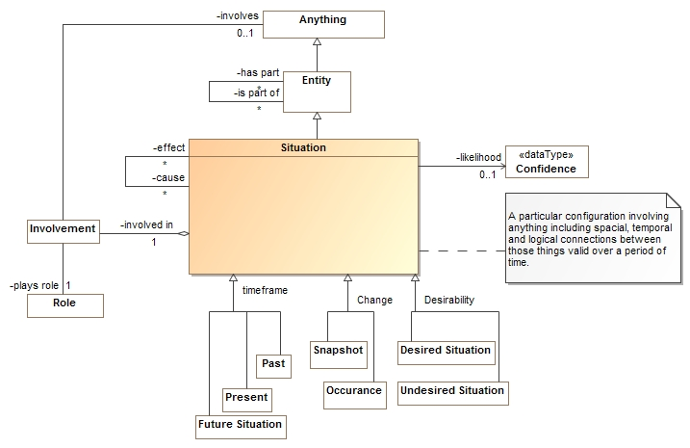
Summarizing Situations

